Slide 1
MATH2010 Probability and STATISTICS
Le DUY DUNG
College of Engineering and Computer Science

Slide 2
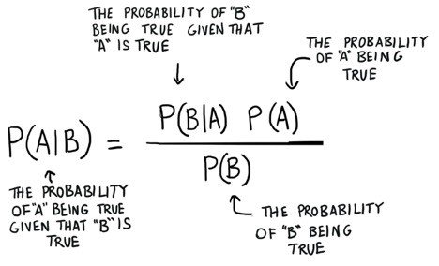
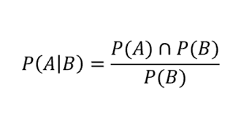

From Lecture 3
Bayes Theorem
Conditional Probability

Slide 3
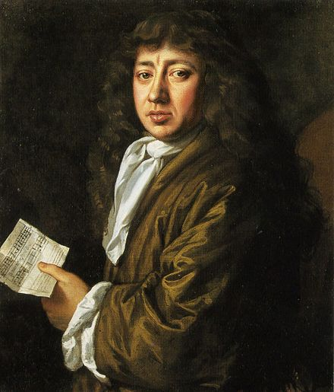
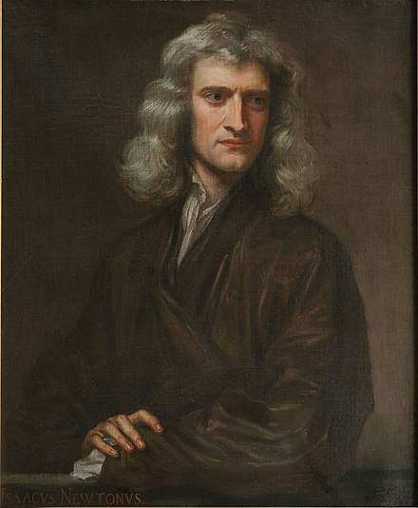
Newton-Pepys Problem
Which of the following three propositions has the greatest chance of success?
Six fair dice are tossed independently and at least one “6” appears.
Twelve fair dice are tossed independently and at least two “6”s appear.
Eighteen fair dice are tossed independently and at least three “6”s appear.
Samuel Pepys
Sir Isaac Newton
https://en.wikipedia.org/wiki/Samuel_Pepys
https://en.wikipedia.org/wiki/Isaac_Newton

Slide 4
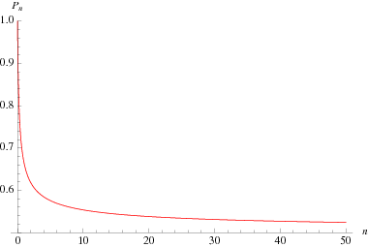
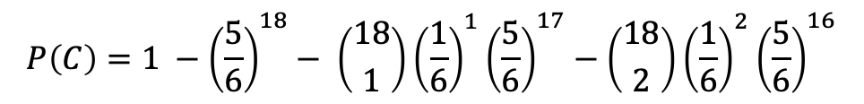
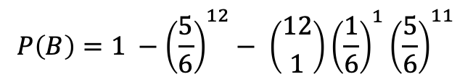
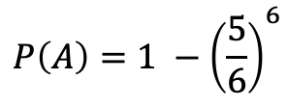
Newton-Pepys Problem
$$P\left(A\right)=1 −{\left(\frac{5}{6}\right)}^{6}$$
$$P\left(B\right)=1 −{\left(\frac{5}{6}\right)}^{12}− \left({12 \atop 1}\right){\left(\frac{1}{6}\right)}^{1}{\left(\frac{5}{6}\right)}^{11}$$
$$P\left(C\right)=1 −{\left(\frac{5}{6}\right)}^{18}− \left({18 \atop 1}\right){\left(\frac{1}{6}\right)}^{1}{\left(\frac{5}{6}\right)}^{17}−\left({18 \atop 2}\right){\left(\frac{1}{6}\right)}^{2}{\left(\frac{5}{6}\right)}^{16}$$
https://mathworld.wolfram.com/Newton-PepysProblem.html

Slide 5
Discrete Random Variables

Slide 6
Learning GOALS – Discrete Random Variables
Know the definitions of discrete random variable
Be able to describe the probability mass function and cumulative distribution function of a discrete random variable
Be able to compute the expectation of a discrete random variable

Slide 7
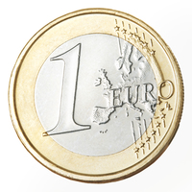
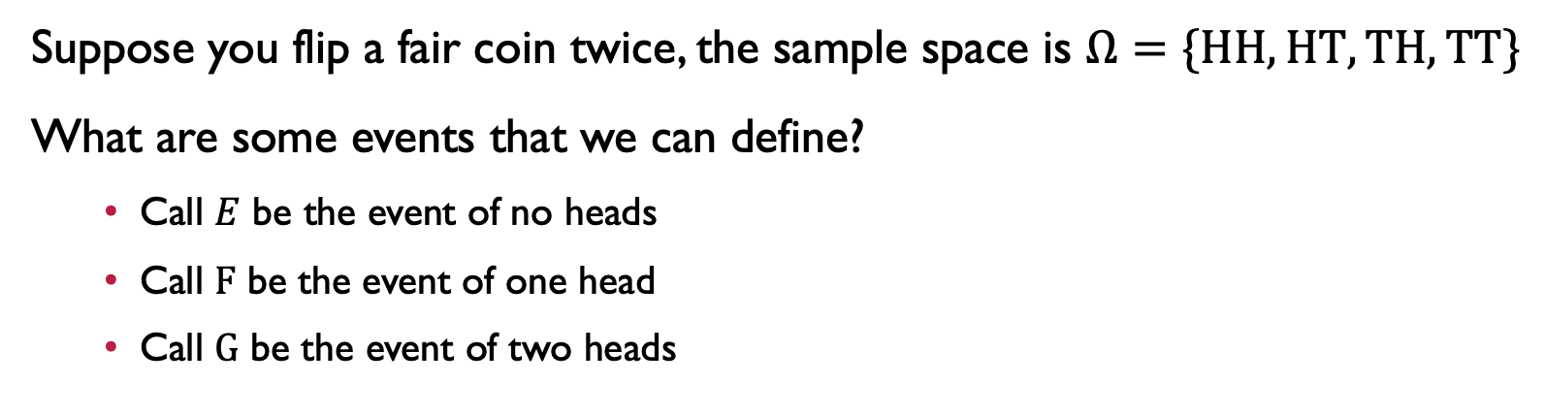
Flipping A coin Twice
Suppose you flip a fair coin twice, the sample space is $Ω=\{HH, HT, TH, TT\}$
What are some events that we can define?
Call $E$ be the event of no heads
Call $F$ be the event of one head
Call $G$ be the event of two heads
This is a bit tedious! It would be nice to have some general way of defining events in terms of numbers (in this case, the number of heads)

Slide 8





Flipping A coin Twice
Sample space is $Ω=\{HH, HT, TH, TT\}$
Let $X$ be the number of heads in two independent flips of a fair coin.
$X$ is a function from $Ω → R$, which maps an outcome $ω∈Ω$ to a number
HH
HT
TH
TT
2
1
0
$$X\left(HH\right)=2$$
$$X\left(HT\right)= X\left(TH\right)=1$$
$$X\left(TT\right)=0$$
$$Ω$$
$$R$$

Slide 9
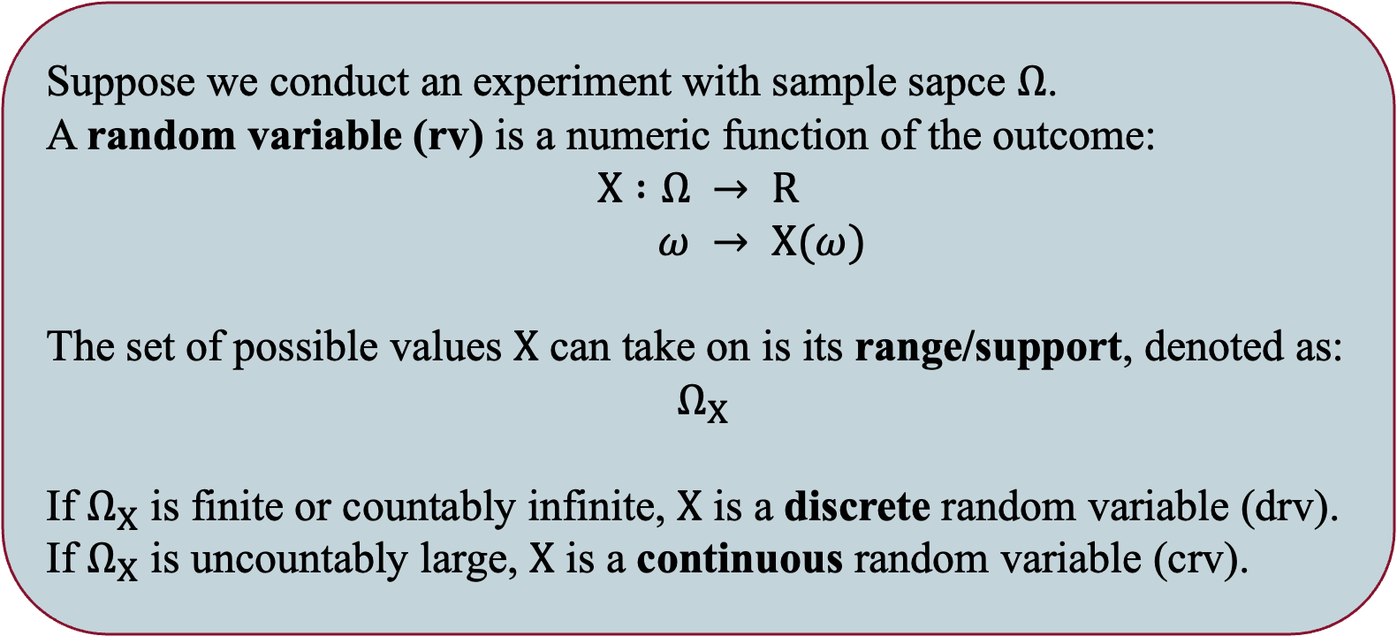
Random Variable
Suppose we conduct an experiment with sample sapce $Ω$.
A random variable (rv) is a numeric function of the outcome:
$$X :Ω → R$$
$ω → X(ω)$
The set of possible values $X$ can take on is its range/support, denoted as:
$Ω_{X}$
If $Ω_{X}$ is finite or countably infinite, $X$ is a discrete random variable (drv).
If $Ω_{X}$ is uncountably large, $X$ is a continuous random variable (crv).

Slide 10

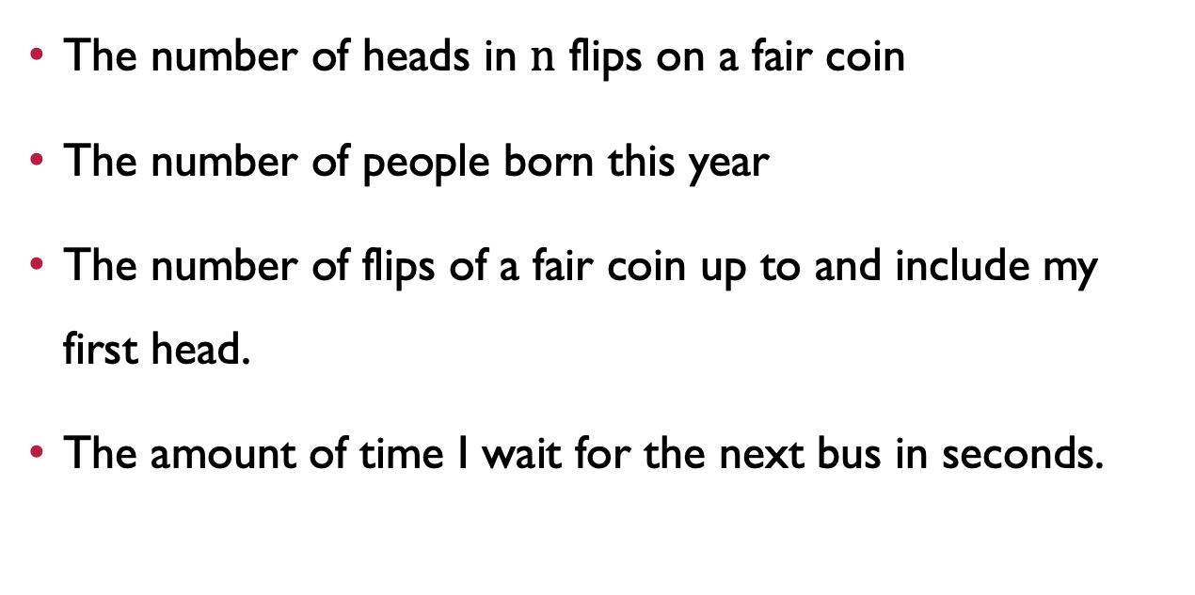

Random Variable Examples
$$Ω_{X}$$
$drv$ or crv
The number of heads in $n$ flips on a fair coin
The number of people born this year
The number of flips of a fair coin up to and include my first head.
The amount of time I wait for the next bus in seconds.

Slide 11
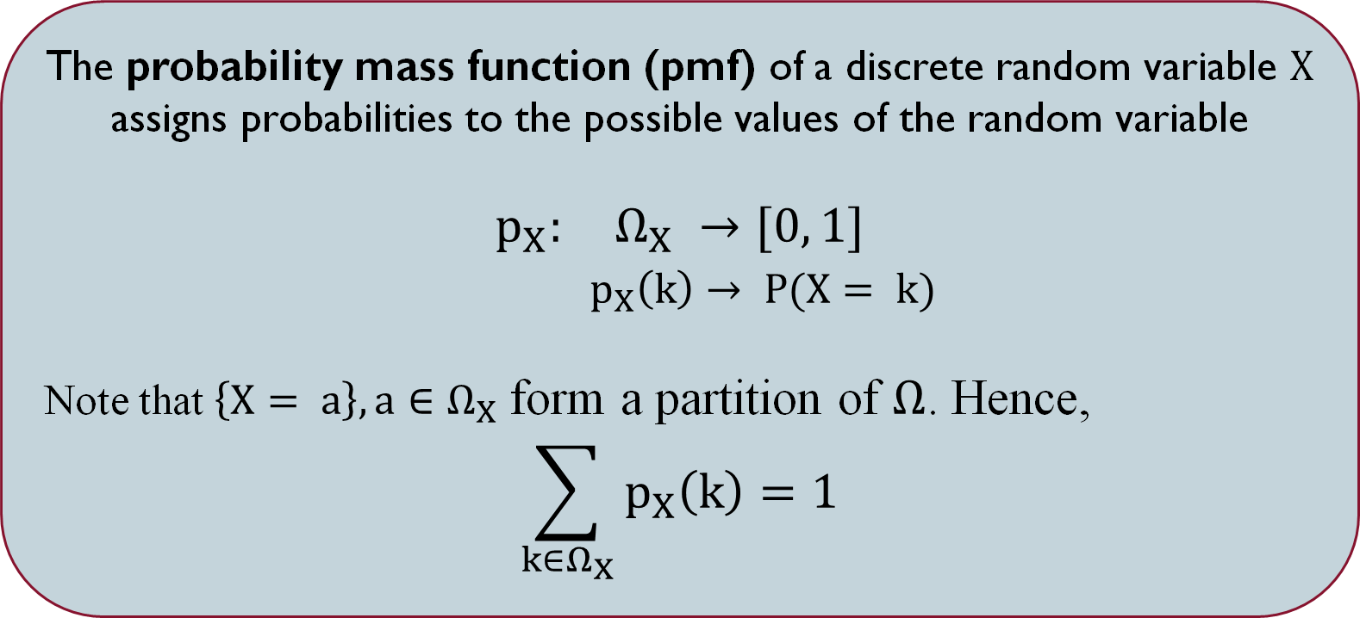
Probability Mass Function (PMF)
The probability mass function (pmf) of a discrete random variable $X$ assigns probabilities to the possible values of the random variable
$$p_{X}: Ω_{X} →[0, 1]$$
$p_{X}\left(k\right)→ P(X= k)$
Note that $\left\{X= a\right\}, a∈Ω_{X}$ form a partition of $Ω$. Hence,
$$\sum_{k∈Ω_{X}}{p_{X}\left(k\right)=1}$$

Slide 12
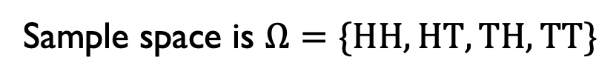
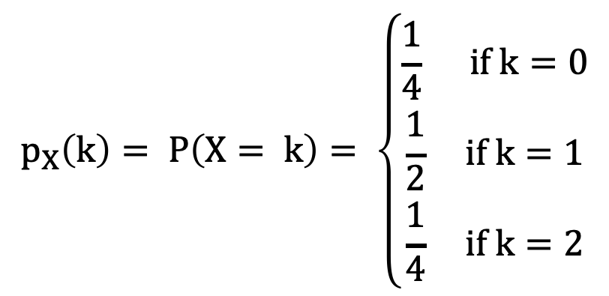

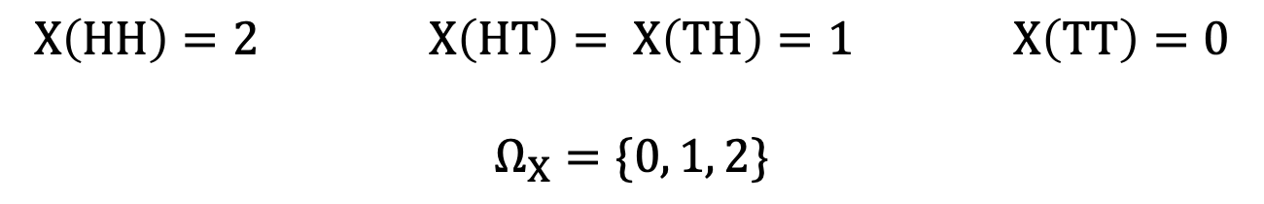
Flipping A coin Twice
Sample space is $Ω=\{HH, HT, TH, TT\}$
$$X\left(HH\right)=2 X\left(HT\right)= X\left(TH\right)=1 X\left(TT\right)=0$$
$$Ω_{X}=\{0, 1, 2\}$$
What are the probabilities $X$ takes on these values?
We define the probability mass function (pmf) of $X$, as $p_{X}:Ω_{X} →[0, 1]$
$$p_{X}\left(k\right)= P\left(X= k\right)= \left\{\begin{aligned}\frac{1}{4} if k=0 \\ \frac{1}{2} if k=1 \\ \frac{1}{4} if k=2\end{aligned}\right.$$

Slide 13
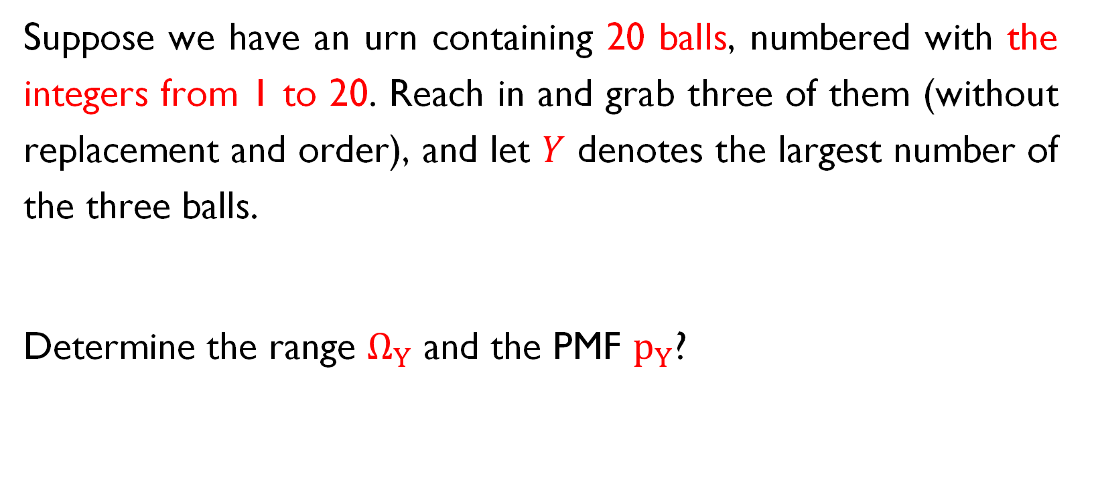
PMF Examples
Suppose we have an urn containing 20 balls, numbered with the integers from 1 to 20. Reach in and grab three of them (without replacement and order), and let $Y$ denotes the largest number of the three balls.
Determine the range $Ω_{Y}$ and the PMF $p_{Y}$?

Slide 14
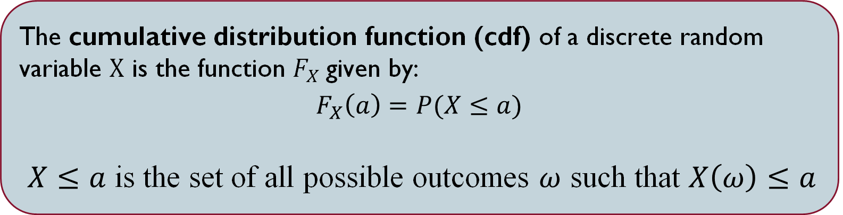
Cumulative Distribution Function (CDF)
The cumulative distribution function (cdf) of a discrete random variable $X$ is the function $F_{X}$given by:
$F_{X}\left(a\right)=P(X≤a)$
$X≤a$ is the set of all possible outcomes $ω$ such that $X\left(ω\right)≤a$

Slide 15
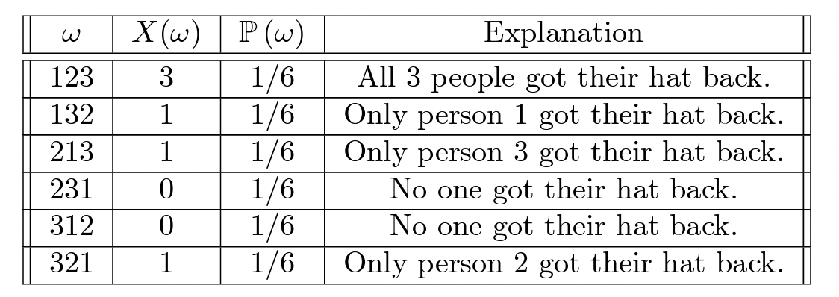

EXAMPLE
Suppose there are three students, and their hats are returned randomly with each of the 3! permutations equally likely. Let $X$ be the number of hats returned to the correct owner.
Find the range $Ω_{X}$ and PMF $p_{X}$
Find the CDF $F_{X}$

Slide 16
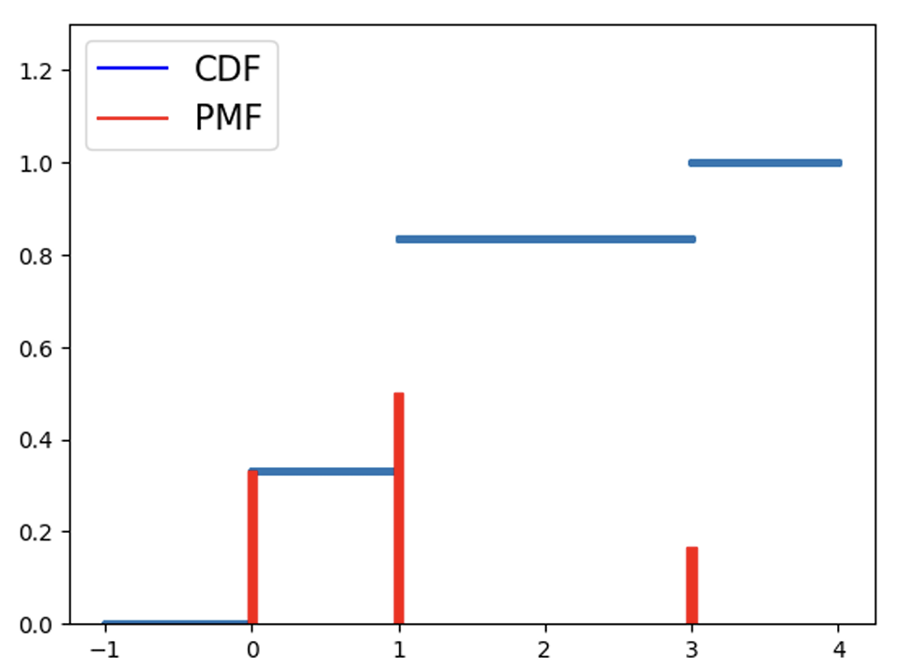
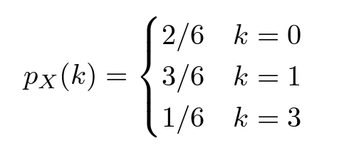
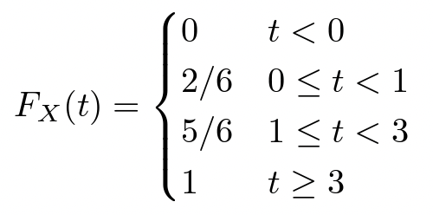
EXAMPLE

Slide 17

Properties of the CDF $F_{X}$
$F_{X}$ is non-decreasing, or symbolically $a≤b$ then $F_{X}\left(a\right)≤F_{X}(b)$
${0≤ F}_{X}\left(a\right)≤1$
${\lim_{a → ∞}{F}}_{X}(a)=1$ and ${\lim_{a →−∞}{F}}_{X}(a)=0$

Slide 18
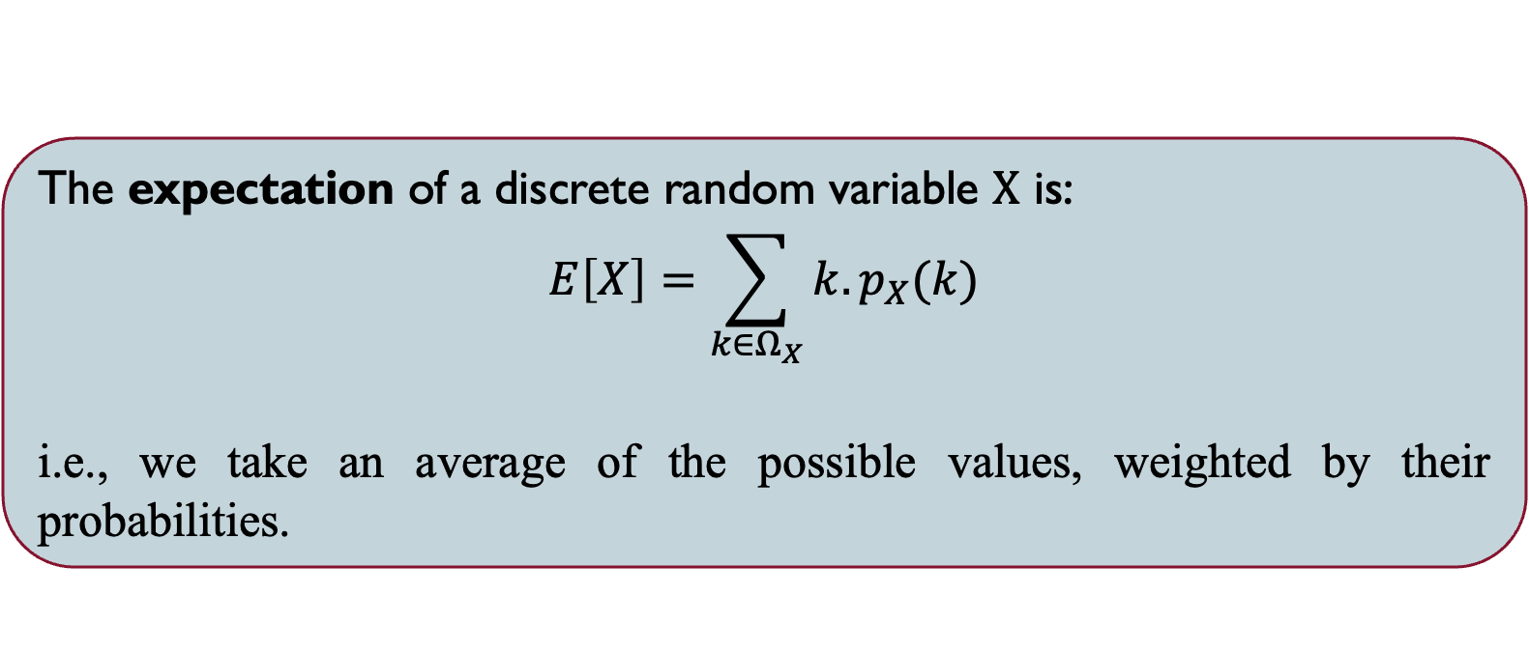
EXPECTATION
The expectation of a discrete random variable $X$ is:
$$E\left[X\right]=\sum_{k∈Ω_{X}}{k.p_{X}(k)}$$
i.e., we take an average of the possible values, weighted by their probabilities.

Slide 19


EXAMPLE
Suppose there are three students, and their hats are returned randomly with each of the 3! permutations equally likely. Let $X$ be the number of hats returned to the correct owner.
Find the expected number of people who got their hat back, $E(X)$?
$$Ω_{X}=\{0, 1, 3\}$$

Slide 20
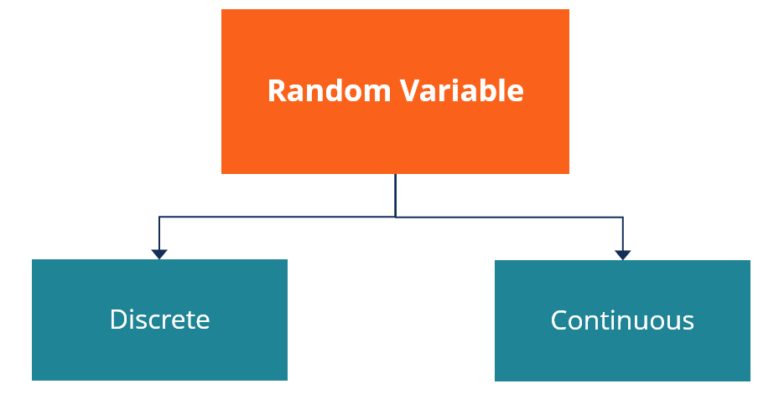
What You Have Learnt
Probability Mass Function
Expectation
Cummulative Distribution Function

Slide 21
One more thing …

Slide 22


